Slide 1
Deploying the zomato application using docker

Slide 2
Docker
Docker is an open-source platform designed to make it easier to create, deploy, and run applications by using containers. Containers allow developers to package an application with all of its dependencies, libraries, and configuration files, ensuring that it runs consistently across different environments.
Key Features of Docker:
Lightweight: containers share the host operating system's kernel, making them more resource-efficient compared to traditional virtual machines.
Portability: Containers can run consistently in any environment, whether it's a developer's local machine, a testing environment, or production servers.

Slide 3
3. Isolation: Each container operates independently, ensuring security and preventing conflicts between applications.
4. Scalability: Docker makes it easy to scale applications horizontally by running multiple containers.
Core Components:
Docker Engine: The runtime responsible for building and running containers.
Dockerfile: A text file containing instructions for building a Docker image.
Images: Immutable snapshots that contain everything needed to run an application (code, runtime, libraries, etc.).
Containers: Running instances of Docker images.
Docker Hub: A public registry for sharing and downloading Docker images.

Slide 4
SonarQube:
SonarQube is an open-source platform used for continuous inspection of code quality. It helps developers identify and fix issues by analyzing code for bugs, vulnerabilities, code smells, and other quality metrics. SonarQube is commonly used in DevOps pipelines to ensure that code adheres to quality standards before deployment.
Key Features of SonarQube
1.Multi-Language Support:
Supports over 25 programming languages, including Java, Python, JavaScript, C#, C++, and more.
2. Code Quality Analysis:
Detects bugs, vulnerabilities, code smells, and duplicated code.
Measures code coverage, cyclomatic complexity, and maintainability.

Slide 5
3.Static Code Analysis:
Analyzes code without running it, providing early feedback during development.
Integration with DevOps Tools:
Works with Jenkins, GitLab, Azure DevOps, Bitbucket, GitHub, and other CI/CD tools.
4.Dashboards & Reports:
Offers visual dashboards to monitor code quality trends.
Provides detailed reports for each scan.
5.Customizable Rules:
Users can define or modify rules to suit their coding standards and project requirements.
6.Security Checks:
Complies with standards like OWASP Top 10 and SANS Top 25 to ensure secure code.

Slide 6
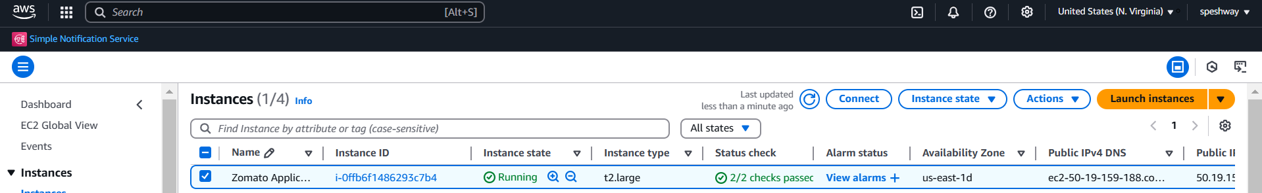
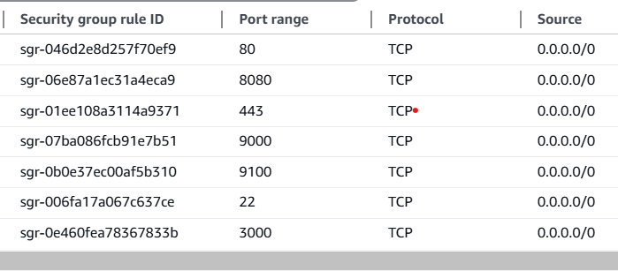
To deploy the application we need to create the aws instance and connect the instance to the Jenkins dashboard
Take Ubuntu server with t2 large and 30gib of data storage
Add the additional security groups

Slide 7
Install AWS CLI Jenkins, docker, Trivy and SonarQube
Connect to the instance
Update the packages
switch to root user ---> sudo su
sudo apt update -y
Install AWS CLI
sudo apt install unzip -y
curl "https://awscli.amazonaws.com/awscli-exe-linux-x86_64.zip" -o "awscliv2.zip"
unzip awscliv2.zip
sudo ./aws/install

Slide 8
Install Jenkins on Ubuntu
sudo apt update -y
wget -O - https://packages.adoptium.net/artifactory/api/gpg/key/public | sudo tee /etc/apt/keyrings/adoptium.asc
echo "deb [signed-by=/etc/apt/keyrings/adoptium.asc] https://packages.adoptium.net/artifactory/deb $(awk -F= '/^VERSION_CODENAME/{print$2}' /etc/os-release) main" | sudo tee /etc/apt/sources.list.d/adoptium.list
sudo apt update -y
sudo apt install temurin-17-jdk -y
/usr/bin/java –version
curl -fsSL https://pkg.jenkins.io/debian-stable/jenkins.io-2023.key | sudo tee /usr/share/keyrings/jenkins-keyring.asc > /dev/null

Slide 9
echo deb [signed-by=/usr/share/keyrings/jenkins-keyring.asc] https://pkg.jenkins.io/debian-stable binary/ | sudo tee /etc/apt/sources.list.d/jenkins.list > /dev/null
sudo apt-get update -y
sudo apt-get install jenkins -y
sudo systemctl start jenkins
sudo systemctl status Jenkins
Verifiy Jenkins installation: jenkins –version
Install Docker on Ubuntu
sudo apt-get update
sudo apt-get install ca-certificates curl
sudo install -m 0755 -d /etc/apt/keyrings

Slide 10
sudo curl -fsSL https://download.docker.com/linux/ubuntu/gpg -o /etc/apt/keyrings/docker.asc
sudo chmod a+r /etc/apt/keyrings/docker.asc
# Add the repository to Apt sources:
echo \
"deb [arch=$(dpkg --print-architecture) signed-by=/etc/apt/keyrings/docker.asc] https://download.docker.com/linux/ubuntu \
$(. /etc/os-release && echo "$VERSION_CODENAME") stable" | \
sudo tee /etc/apt/sources.list.d/docker.list > /dev/null
sudo apt-get update
sudo apt-get install docker-ce docker-ce-cli containerd.io docker-buildx-plugin docker-compose-plugin -y
sudo usermod -aG docker ubuntu
sudo chmod 777 /var/run/docker.sock

Slide 11
newgrp docker
sudo systemctl status docker
Verifiy Docker installation: docker –version
Install Trivy on Ubuntu
sudo apt-get install wget apt-transport-https gnupg
wget -qO - https://aquasecurity.github.io/trivy-repo/deb/public.key | gpg --dearmor | sudo tee /usr/share/keyrings/trivy.gpg > /dev/null
echo "deb [signed-by=/usr/share/keyrings/trivy.gpg] https://aquasecurity.github.io/trivy-repo/deb generic main" | sudo tee -a /etc/apt/sources.list.d/trivy.list
sudo apt-get update
sudo apt-get install trivy
Verifiy Trivy installation: trivy --version

Slide 12
Install SonarQube using Docker
$ docker run -d --name sonar -p 9000:9000 sonarqube:lts-community
$ docker ps (You can see SonarQube container)
Installation of Plugins in Jenkins
Docker plugin
docker-build-step
Eclipse Temurin installer Plugin
Email Extension Template Plugin
Matrix Authorization Strategy Plugin
NodeJS Plugin

Slide 13
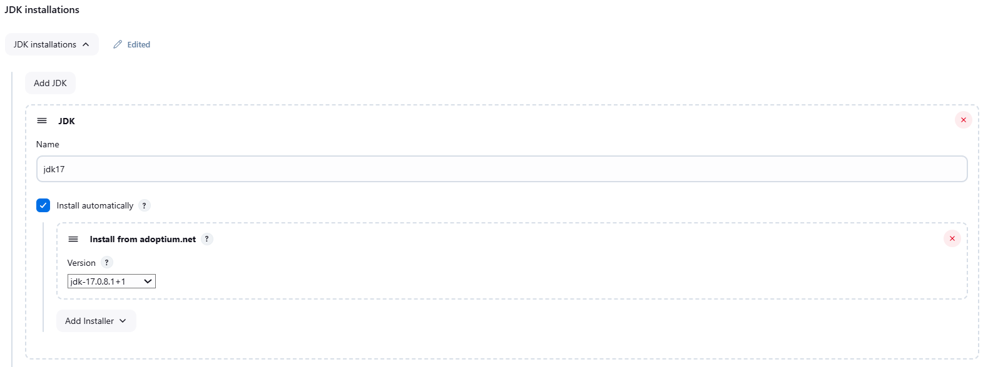
OWASP Dependency-Check Plugin
OWASP Dependency-Track Plugin
Pipeline: Stage View Plugin
Prometheus metrics plugin
SonarQube Scanner for Jenkins
Open Jenkins dashboard and manager Jenkins add the tools
Add jdk

Slide 14
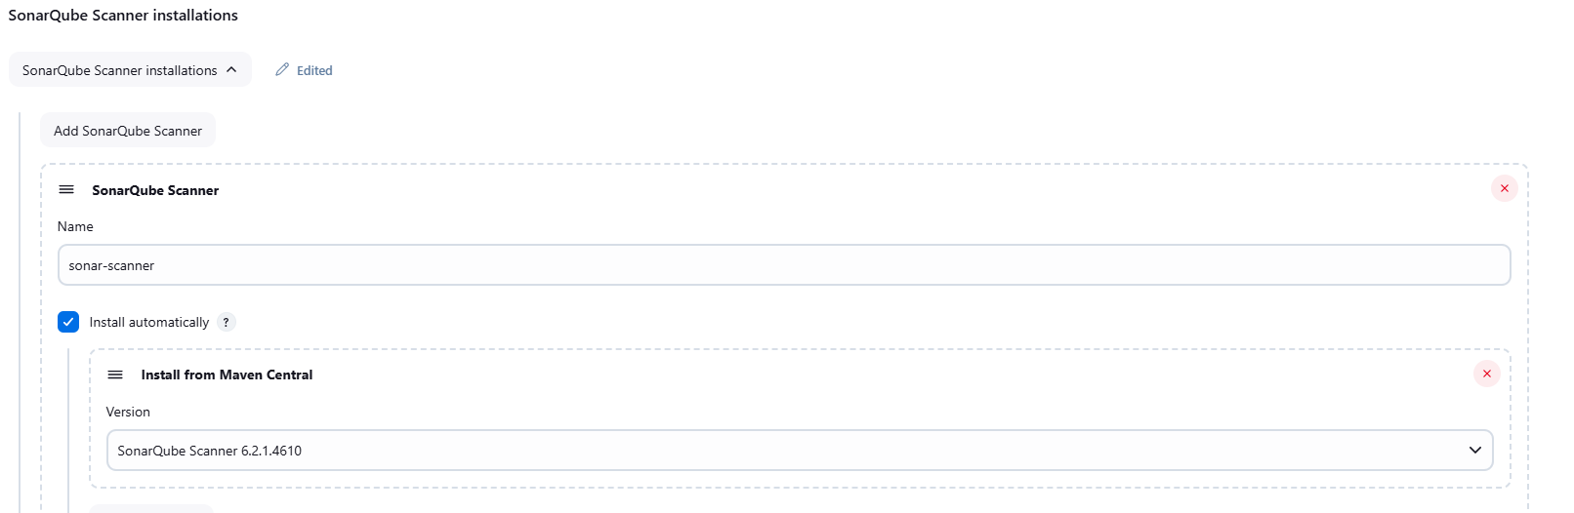
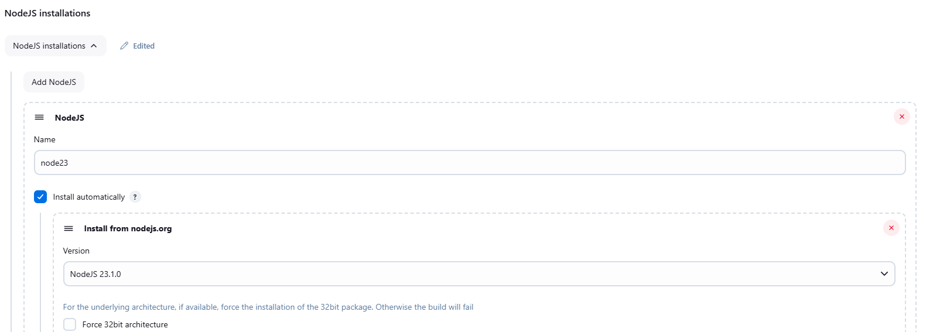
Add sonarqube installation
Add NodeJS installation

Slide 15
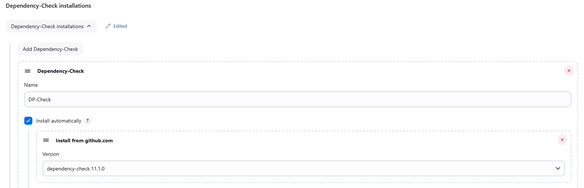
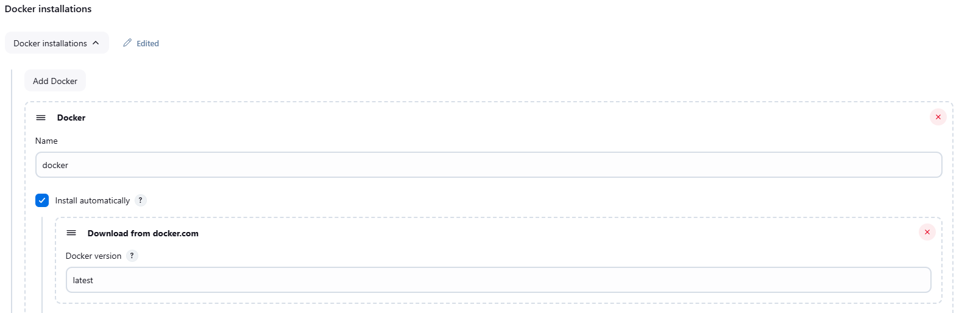
Add Dependency-Check Installation
Add Docker installations

Slide 16
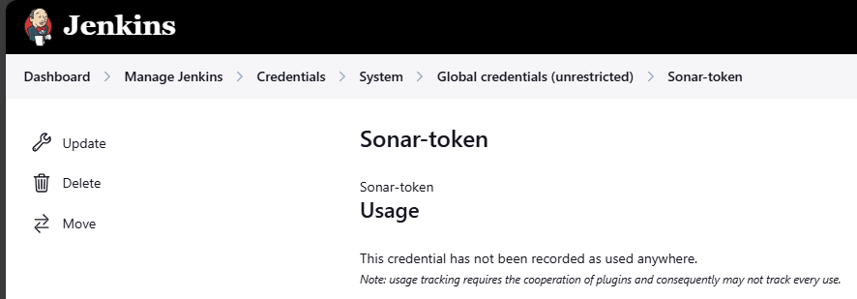
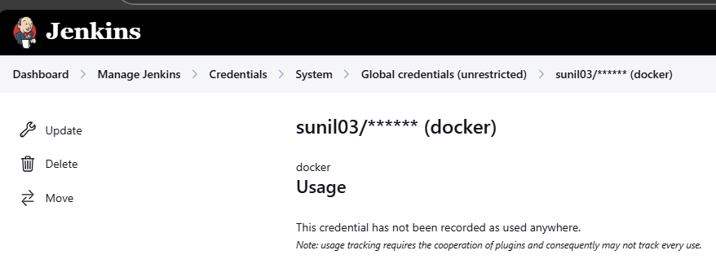
Add sonar token

Slide 17
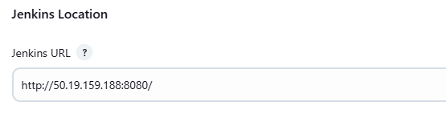
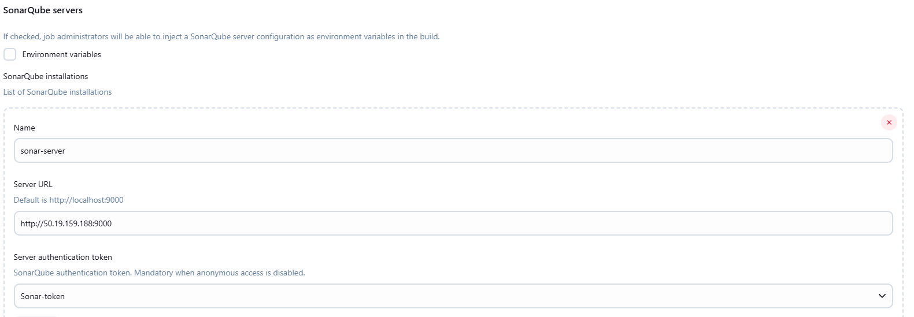
Add Jenkins url
Add sonarqube server Url

Slide 18
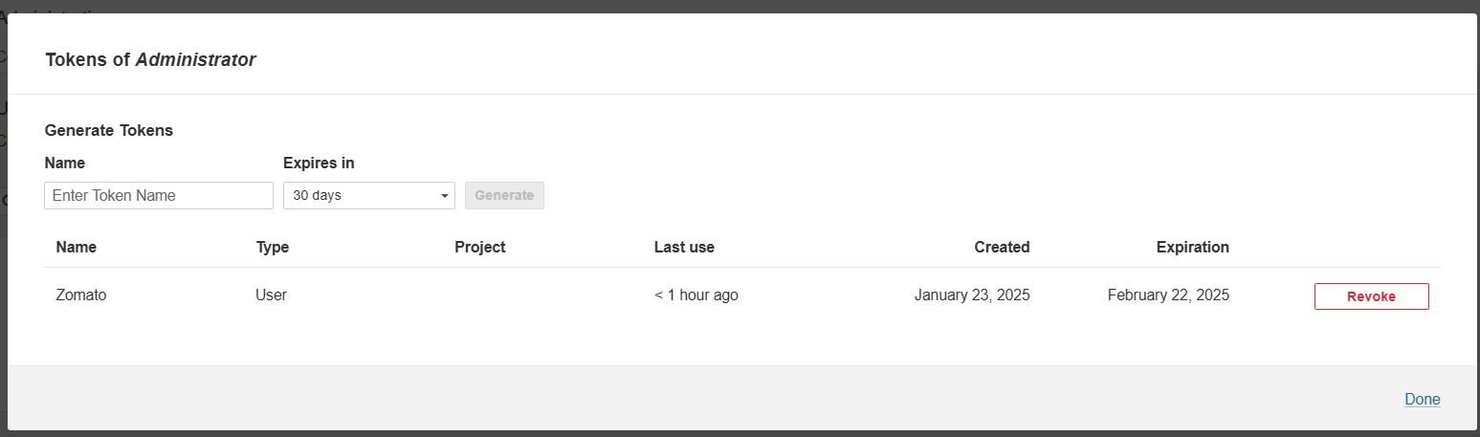
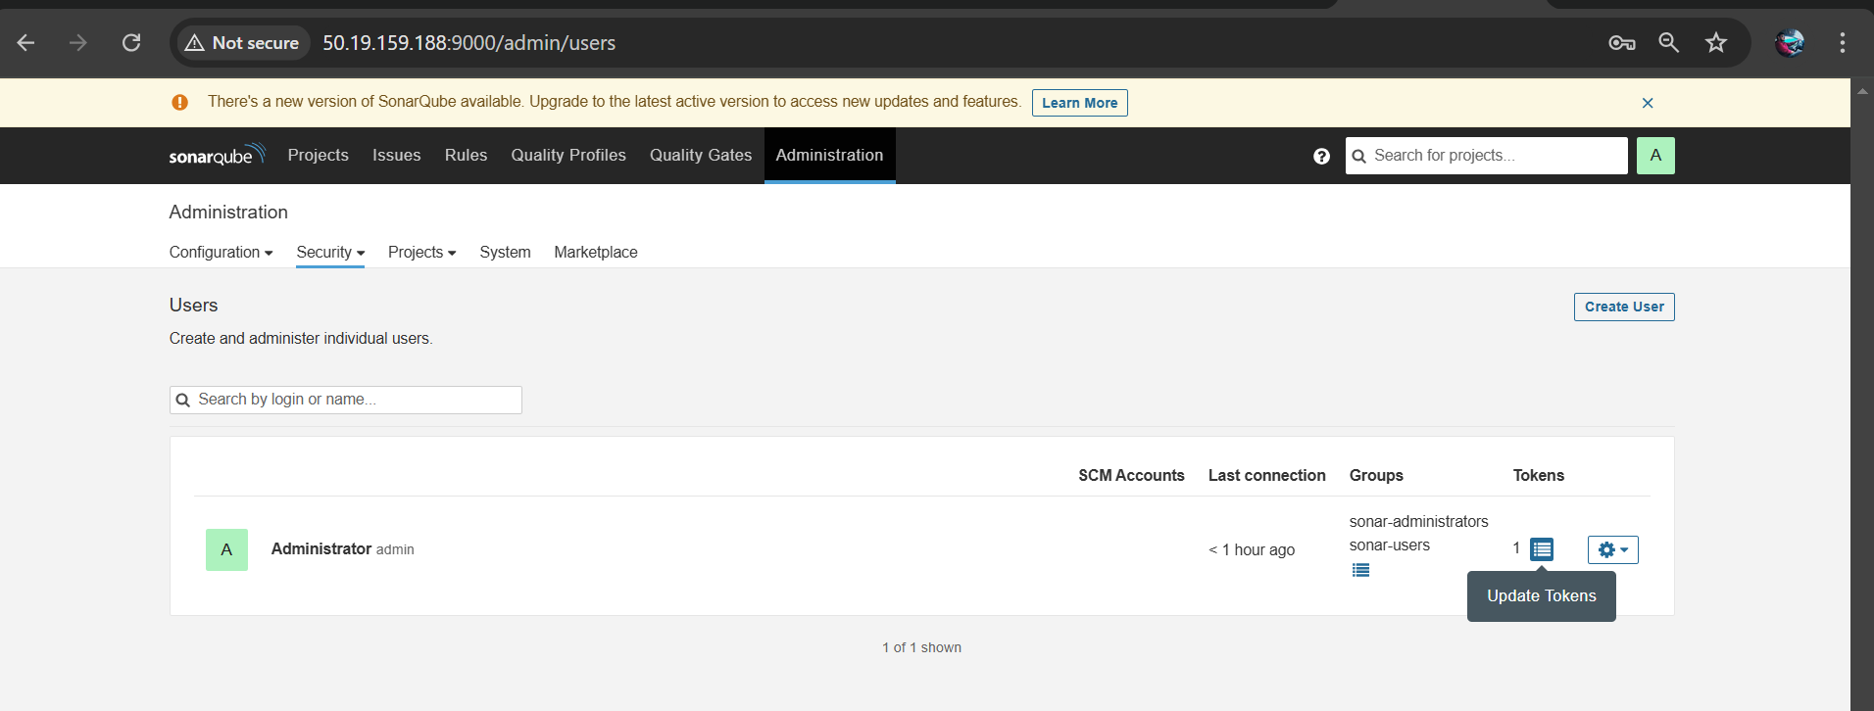
Add the sonar token

Slide 19
Jenkins pipeline to deploy the application
pipeline {
agent any
tools {
jdk 'jdk17'
nodejs 'node23'
}
environment {
SCANNER_HOME=tool 'sonar-scanner'
}
stages {
stage ("clean workspace") {
steps {
cleanWs()
}
}

Slide 20
stage ("Git Checkout") {
steps {
git 'https://github.com/KastroVKiran/Zomato-Project-Kastro.git'
}
}
stage("Sonarqube Analysis"){
steps{
withSonarQubeEnv('sonar-server') {
sh ''' $SCANNER_HOME/bin/sonar-scanner -Dsonar.projectName=zomato \
-Dsonar.projectKey=zomato '''
}
}
}
stage("Code Quality Gate"){
steps {
script {
waitForQualityGate abortPipeline: false, credentialsId: 'Sonar-token'
}
}
}

Slide 21
stage("Install NPM Dependencies") {
steps {
sh "npm install"
}
}
stage('OWASP FS SCAN') {
steps {
dependencyCheck additionalArguments: '--scan ./ --disableYarnAudit --disableNodeAudit', odcInstallation: 'DP-Check'
dependencyCheckPublisher pattern: '**/dependency-check-report.xml'
}
}
stage ("Trivy File Scan") {
steps {
sh "trivy fs . > trivy.txt"
}
}

Slide 22
stage ("Build Docker Image") {
steps {
sh "docker build -t zomato ."
}
}
stage ("Tag & Push to DockerHub") {
steps {
script {
withDockerRegistry(credentialsId: 'docker') {
sh "docker tag zomato sunil03/zomato:latest "
sh "docker push sunil03/zomato:latest "
}
}
}
}

Slide 23
stage ("Deploy to Container") {
steps {
sh 'docker run -d --name zomato -p 3000:3000 sunil03/zomato:latest'
}
}
}
}
If the build stage of "OWASP FS SCAN" shows 'UNSTABLE BUILD' replace the below script in OWASP FS SCAN stage
stage('OWASP FS SCAN') {
steps {

Slide 24
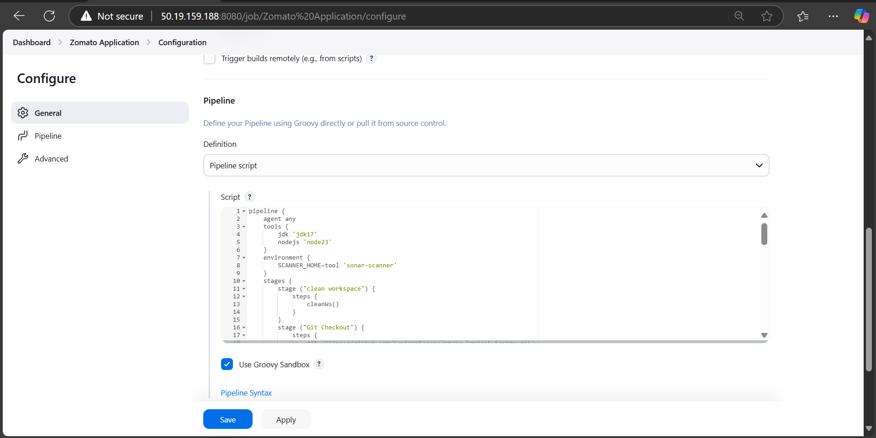
dependencyCheck additionalArguments: '--scan ./ --disableYarnAudit --disableNodeAudit --update -n', odcInstallation: 'DP-Check'
dependencyCheckPublisher pattern: '**/dependency-check-report.xml'
}
}
Now click on save and apply

Slide 25
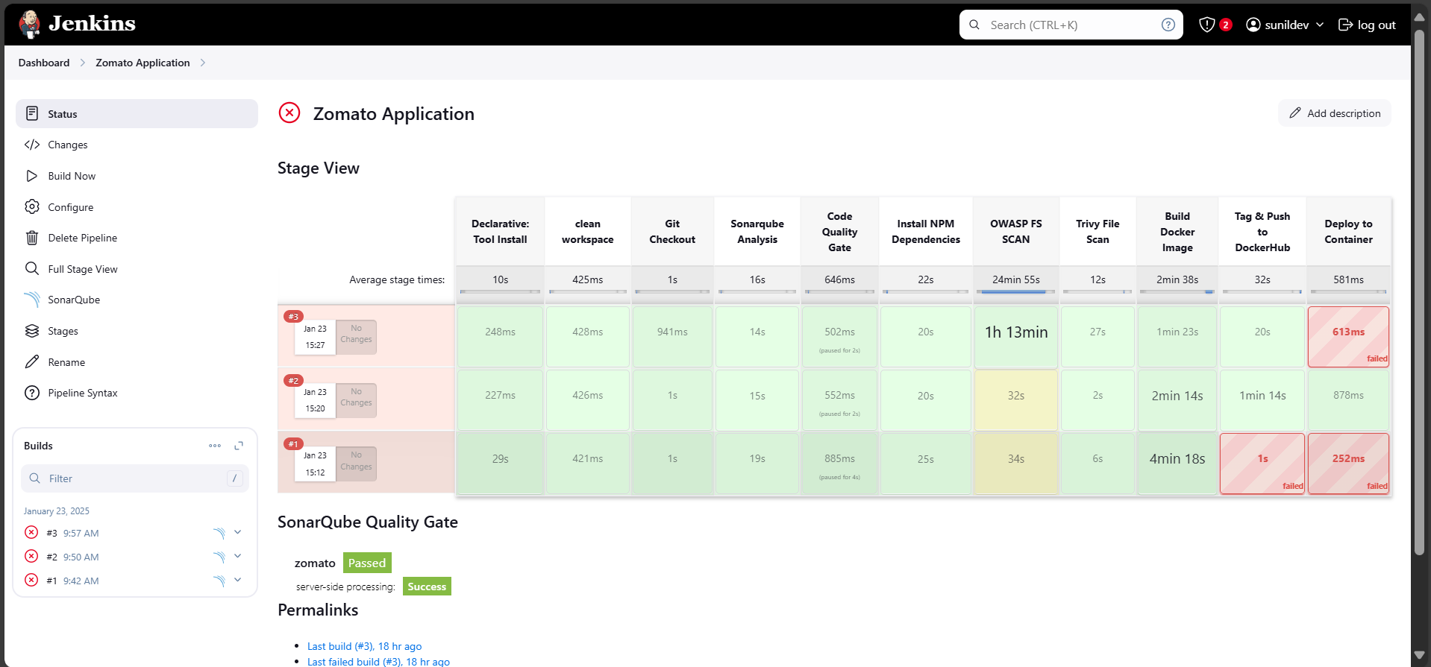
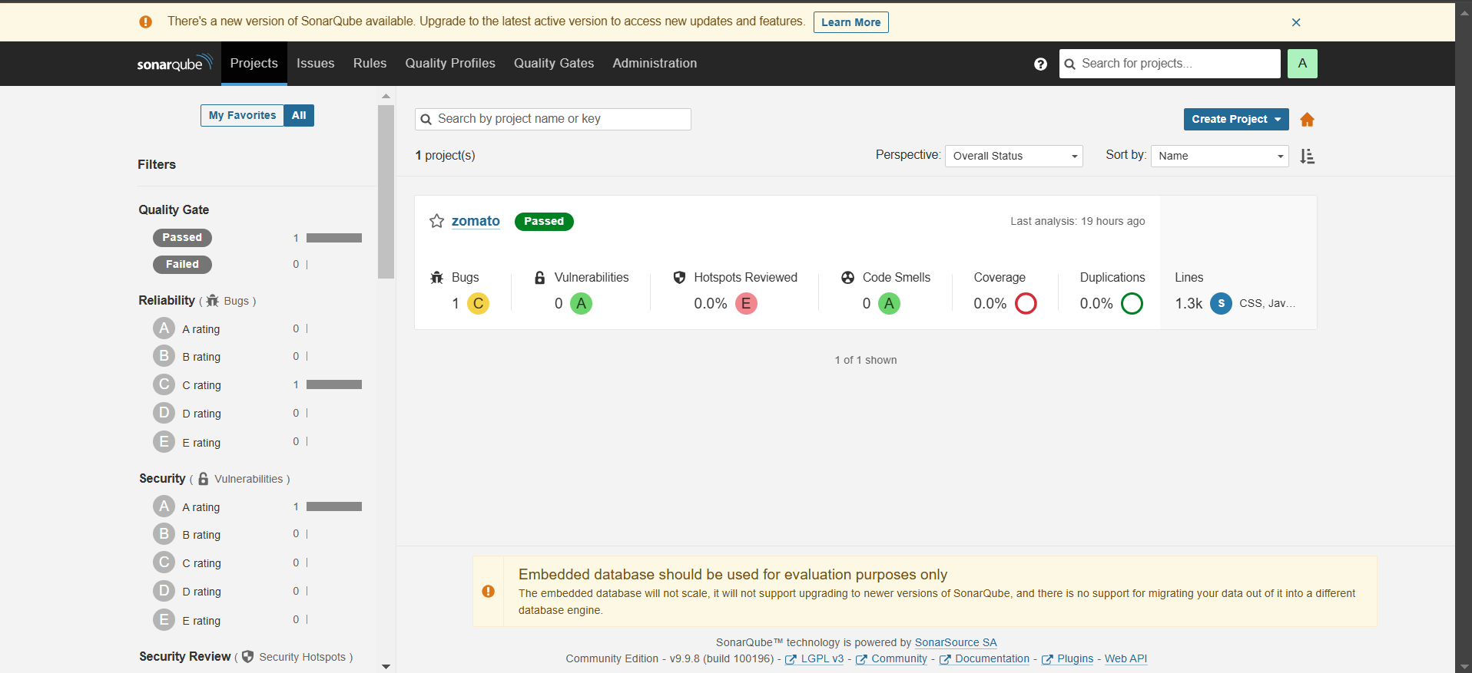
Now click on Build now it takes some time to complete all the builds
Check sonarqube to know the count of bugs in the application

Slide 26
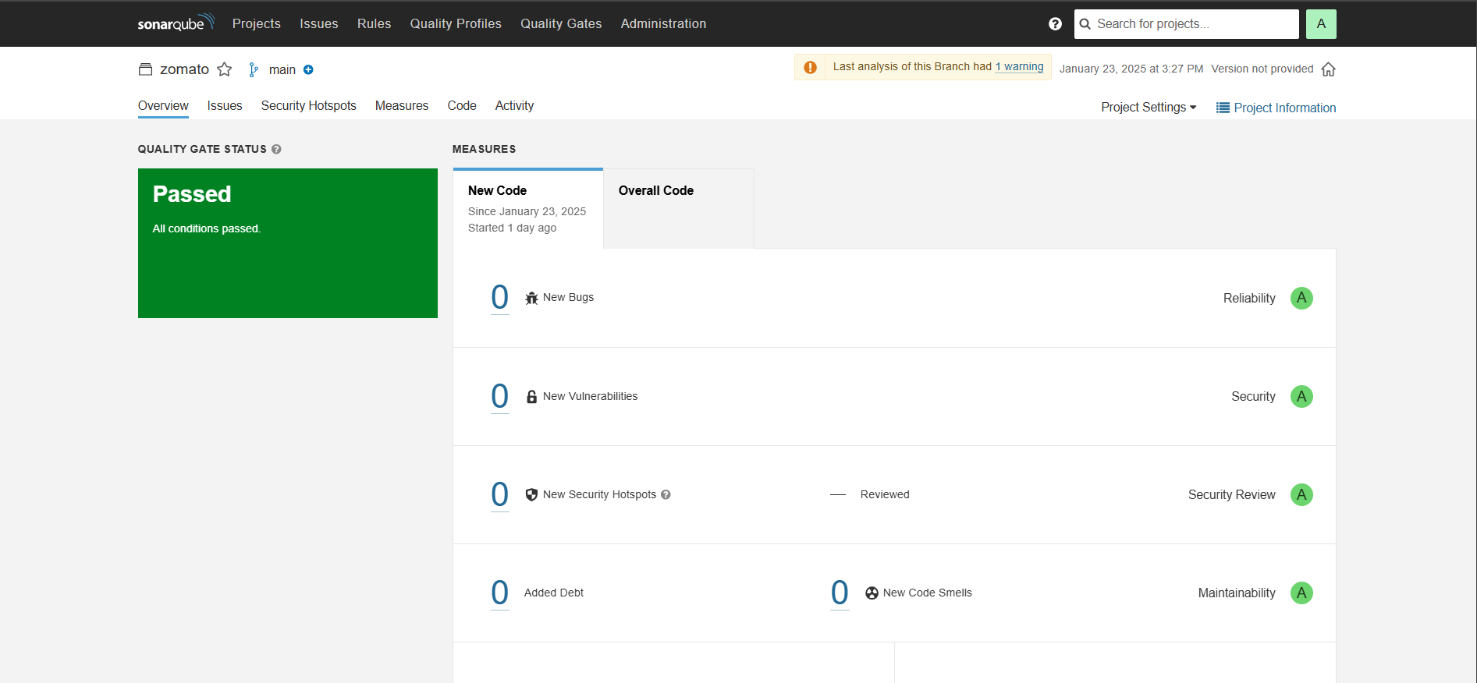
After all conditions got passed we found zero bugs detected
But in overall code we found a bug in the code
Bug should be identified and sent to the developers to fix the code again
After fixing the bug, again the code should be build in Jenkins after build got success then check the sonarqube to find whether the bug is fixed successful or not

Slide 27
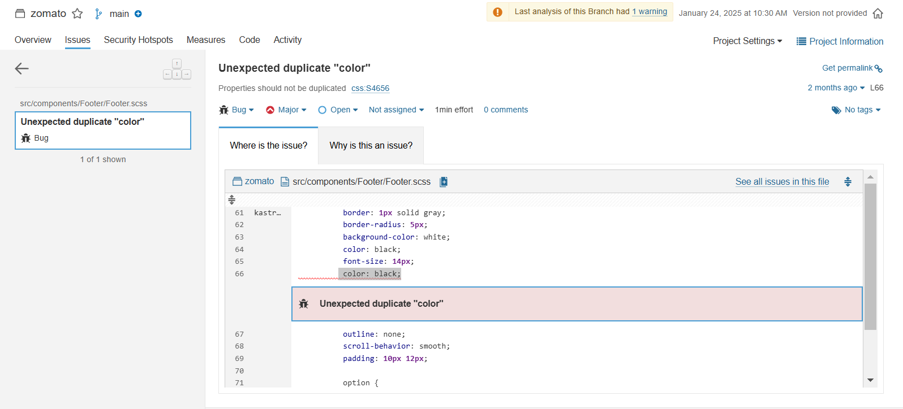
Here we found that unexpected duplicate colour “Black” which is repeated twice in the code, it is bug which we got in the code.
It should be fixed by the developers

Slide 28
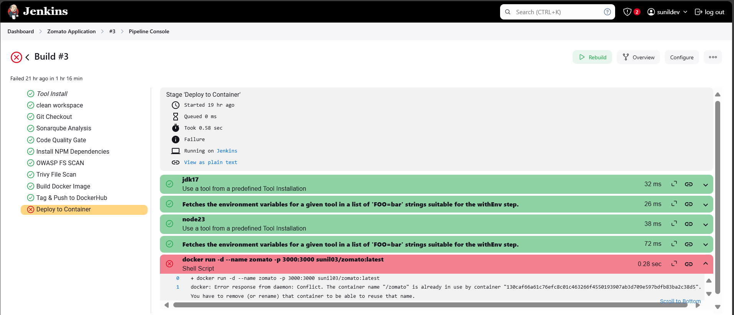
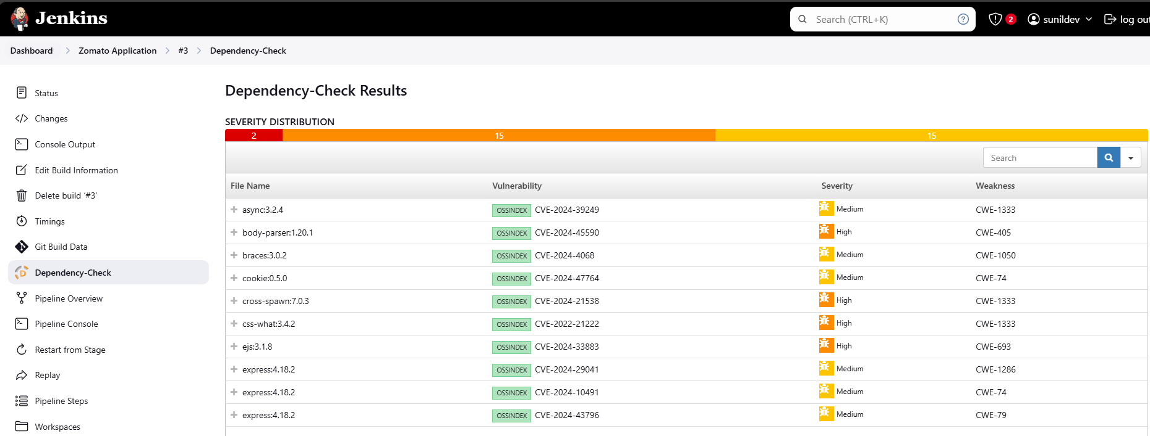
Pipeline Console
Dependency check result

Slide 29
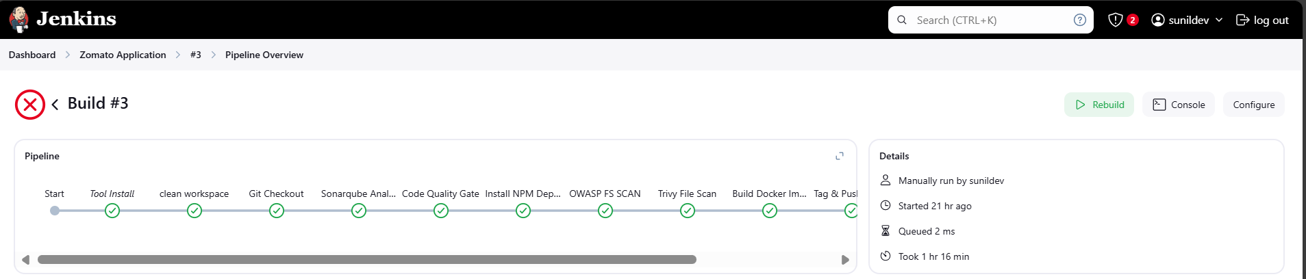
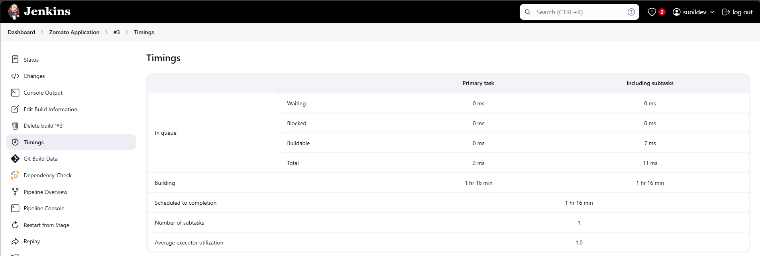
Pipeline over view
Time taken for complete build

Slide 30
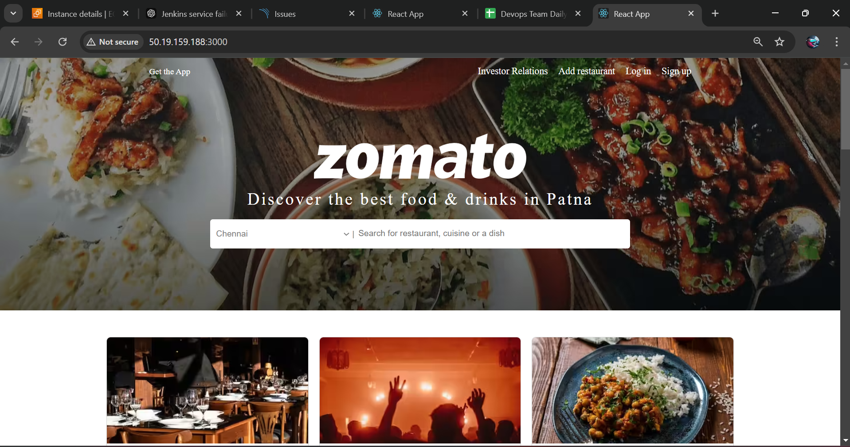
Now copy the public IP of the intannce and paste in the google with the port id 3000
Public IP:3000 to access the application

